Slide 1
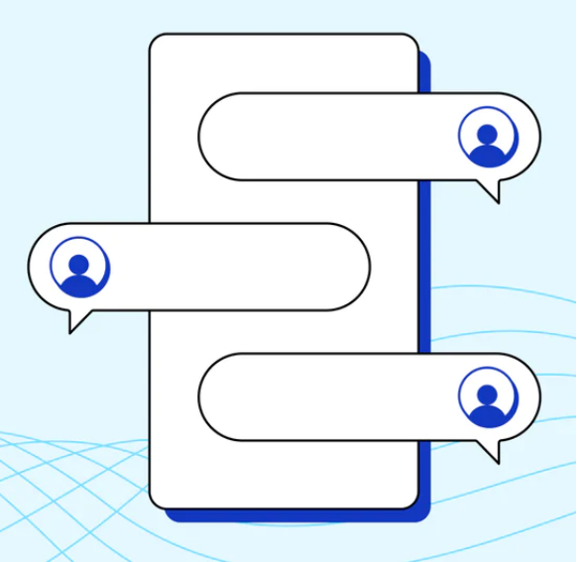
Conversational AI: The Future of Chatbots
GROUP:14
Rishik Chandupatla
Mounika Davuluri
Prudhvi Karthik Dhanekula

Slide 2
CHAT BOT
Chatbots are dynamic computer programs designed to interact with users through natural language processing. They can be either rule-based or powered by artificial intelligence, constantly learning from user interactions. With a wide range of uses, such as customer service, virtual assistance, and information retrieval, chatbots strive to offer speedy, automated responses in order to improve the user's experience. Ultimately, the success of a chatbot is determined by its programming and underlying algorithms.

Slide 3
Project Objectives
Develop a web application that accurately simulates human conversation, enhancing user engagement and interaction.
Provide instant, multilingual customer support to meet user needs promptly and maintain a responsive service.
Design a flexible chatbot capable of communicating in multiple languages, catering to diverse user preferences and ensuring a global reach.
Deliver precise and trustworthy information to users, enhancing reliability and building trust, all while optimizing operational costs effectively.

Slide 4
Tools
For Source Code we used
Python: Python is chosen for its versatility and suitability for AI development, particularly in natural language processing tasks.
Visual Studio Code: VS Code serves as a lightweight, highly extensible code editor offering features like code highlighting, debugging, and version control integration, enhancing development productivity.
Flask: Flask is a micro web framework for Python that simplifies handling HTTP requests and responses, ideal for building the web-based interface of the chatbot.
For Designing Interface we used:
HTML: HTML is essential for creating the structure and content of web pages, providing the foundation for the chatbot's user interface.
CSS: CSS controls the visual presentation of web content, allowing customization of the chatbot's appearance for a visually appealing user interface.
jQuery: jQuery simplifies client-side scripting and adds interactivity to web pages, enhancing the chatbot's user experience through dynamic features and event handling.

Slide 5
Procedures
Data Set
Training
Testing
Weather Forecasting

Slide 6
Code Modules
Source Code
Intents.json
Weather.py
Training.py
Testing.py
HTML Files
Index.html
Home.html

Slide 8
Deliverables and Evaluation Methodology
We are going to submit the Source code folder and HTML file
For evaluating the project, we can test the accuracy of text processing, semantic understanding, response generation and reliability of information Provided.

Slide 9
Future Work
We can develop chatbots for any purpose, such as educational, industrial, banking, and so on, by altering the dataset for relevant industries. There is no need for changing between the models

Slide 10
THANK YOU !!

